Slide 1
Networks and Communications Security

Slide 2
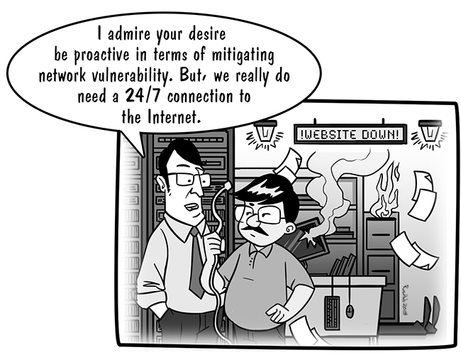

Slide 3
OSI Model
APPLICATION LAYER Network-related application programs
PRESENTATION LAYER Standardization of data presentation to the applications
SESSION LAYER Management of sessions between applications
TRANSPORT LAYER End-to-end error detection and correction
NETWORK LAYER Management of connections across the network
DATA LINK LAYER Reliable data delivery Includes LLC and MAC sub-layers
PHYSICAL LAYER Physical characteristics of the network media

Slide 4
Layer 4 Protocols
ATP – AppleTalk Transaction Protocol
DCCP – Datagram Congestion Control Protocol
FCP – Fiber Channel Protocol
RDP – Reliable Datagram Protocol
SCTP – Stream Control Transmission Protocol
SPX – Sequenced Packet Exchange
SST – Structured Stream Transport

Slide 5
Layer 4 Protocols
SST – Structured Stream Transport
TCP – Transmission Control Protocol
UDP – User Datagram Protocol
UDP Lite – User Datagram Protocol Lite
µTP – Micro Transport Protocol

Slide 6
Layer 5 Protocols
ADSP – AppleTalk Data Stream Protocol
ASP – AppleTalk Session Protocol
H.245 – Call Control Protocol for Multimedia Communication
iSNS – Internet Storage Name Service
PAP – Password Authentication Protocol
PPTP – Point-to-Point Tunneling Protocol
RPC – Remote Procedure Call Protocol

Slide 7
Layer 5 Protocols
RTCP – Real-time Transport Control Protocol
SMPP – Short Message Peer-to-Peer
SCP – Session Control Protocol
SOCKS – SOCKS internet protocol, see Internet socket
ZIP – Zone Information Protocol

Slide 8
Layer 7 Protocols
DHCP – Dynamic Host Configuration Protocol
DHCPv6 – Dynamic Host Configuration Protocol v6
DNS – Domain Name System
HTTP – Hypertext Transfer Protocol
IMAP – Instant Message Access Protocol
IRC – Internet Relay Chat
LDAP – Lightweight Directory Access Protocol

Slide 9
Layer 7 Protocols
XMPP – Extensible Messaging and Presence Protocol
SMTP – Simple Mail Transfer Protocol
FTP – File Transfer Protocol
SFTP – Secure File Transfer Protocol

Slide 10
TCP/IP Reference Model
 | OSI layer |  | TCP/IP layer
7 | Application | 4 | Application
6 | Presentation
5 | Session
4 | Transport | 3 | Transport
3 | Network | 2 | Internet
2 | Data Link | 1 | Network Access
1 | Physical

Slide 11
Internet Protocol (IP) Networking
IP is responsible for sending packets from the source to the destination hosts
Hosts are distinguished by the IP addresses of their network interfaces
The address is expressed as four octets separated by a dot (.), for example, 216.12.146.140
Each octet may have a value between 0 and 255

Slide 12
Network Classes
Class | Range of First Octet | Number of Network Octets | Number of Hosts in Network
A | 1 – 127 | 1 | 16,777,214
B | 128 – 191 | 2 | 65,534
C | 192 – 223 | 3 | 254
D | 224 – 239
E | 240 – 255

Slide 13
IPv6
A much larger address field
Improved security
A more concise IP packet header
Improved quality of service

Slide 14
Transmission Control Protocol (TCP)
The Transmission Control Protocol provides connection-oriented data management and reliable data transfer
Port ranges:
Well-known Ports – (0 – 1023)
Registered Ports – (1024 – 49151)
Dynamic or Private Ports – (49152 – 65535)

Slide 15
ICMP Redirect Attack
A router may send an ICMP redirect to a host to tell it to use a different, more effective default route
However, an attacker can send an ICMP redirect to a host telling it to use the attacker’s machine as a default route

Slide 16
Traceroute Exploitation
Traceroute is a diagnostic tool that displays the path a packet traverses between a source and destination host
Traceroute can be used maliciously to map a victim network and learn about its routing

Slide 17
Carrier Sense Multiple Access (CSMA)
Access protocol that uses the absence/presence of a signal on the medium that it wants to transmit on as permission to speak
Two variations:
Carrier Sense Multiple Access with Collision Avoidance (CSMA/CA)
Carrier Sense Multiple Access with Collision Detection (CSMA/CD)

Slide 18
Token Ring (IEEE 802.5)
Token Ring uses a physical star topography
The logical topography, however, is a ring
Each device receives data from its upstream neighbor and transmits to its downstream neighbor
Token Ring uses ring passing to mediate which device may transmit

Slide 19
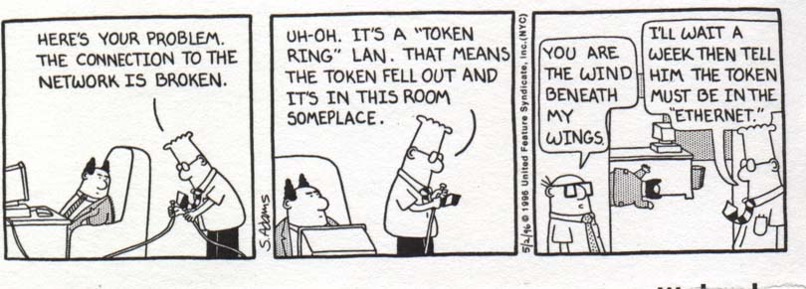

Slide 20
DNS Quick Reference
Ports | 53/TCP,53/UDP
RFC 882 (Original) RFC 1034 (Update to 882) RFC 1035 (Update to 882)

Slide 21
Lightweight Directory Access Protocol (LDAP)
Commonly used for managing user information
Ports | 389/TCP,389/UDP
RFC 1777 (Original)

Slide 22
Network Basic Input Output System (NetBIOS)
Under TCP/IP, NetBIOS runs over TCP on ports 137 and 138 and over UDP on port 139
Ports | 135/UDP 137/TCP 138/TCP 139/UDP
RFC 1001 RFC 1002

Slide 23
Common Internet File System (CIFS)/Server Message Block (SMB)
CIFS/SMB is a file-sharing protocol prevalent on Windows systems
Ports | 445/TCP
Definition Proprietary

Slide 24
File Transfer Protocol (FTP)
Stateful protocol that requires two communication channels
Ports | 20/TCP (data stream)
Definition RFC 959

Slide 25
Hypertext Transfer Protocol (HTTP)
HTTP is the Layer 7 foundation of the World Wide Web (WWW)
Ports | 80/TCP; other ports are in use especially for proxy services
Definition RFC 1945 (HTTP v1.0) RFC 2109 RFC 2616 (HTTP v1.1)

Slide 26
Open Proxy Servers
Allow unrestricted access to GET commands from the Internet
Bears an inherent risk of opening access to protected intranet pages from the Internet

Slide 27
Content Filtering
HTTP proxy is used as a means to implement content filtering that has been defined as, or is assumed to be, nonbusiness related for some reason

Slide 28
HTTP Tunneling
Applied by encapsulating outgoing traffic from an application in an HTTP request and incoming traffic in a response

Slide 29
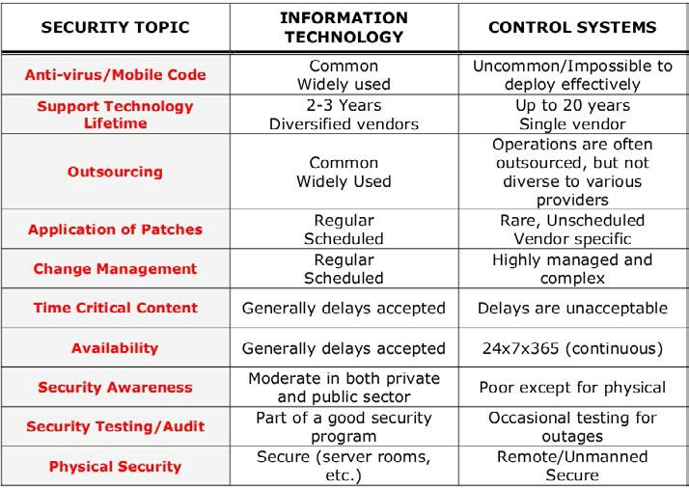
Implication of Multilayer Protocols

Slide 30
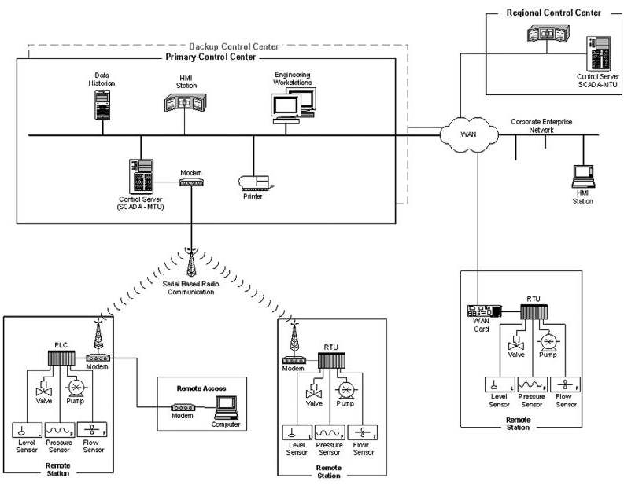
Supervisory Control and Data Acquisition (SCADA)

Slide 31
Defensive Actions
Minimize network exposure for all control system devices
When remote access is required, employ secure methods, such as VPNs
Remove, disable, or rename any default system accounts wherever possible

Slide 32
POTS
Commonly found in the “last mile” of most residential and business telephone services

Slide 33
Attacks and Countermeasures
Attacks on telecommunications systems:
Telecommunication DoS (TDoS) / Distributed DoS (DDoS)
Denial of Service (DoS)
DDoS for Hire
SIP Flooding
Often takes place because attackers are running brute-force password guessing scripts that overwhelm the processing capabilities of the SIP device

Slide 34
Man-in-the-Middle Attack
Malicious party:
Intercepts a legitimate communication between two friendly parties
Then controls the flow of communication
Can eliminate or alter the information sent

Slide 35
Network Partitioning
Segmenting networks into domains of trust is an effective way to help enforce security policies
Controlling which traffic is forwarded between segments protects digital assets

Slide 36
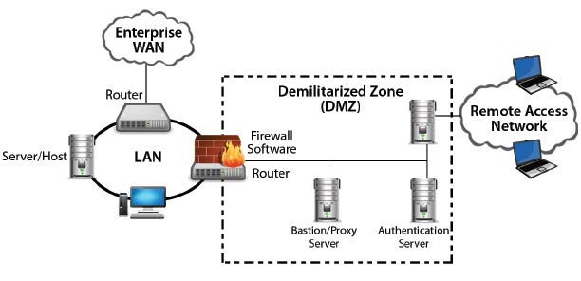
Demilitarized Zone (DMZ)

Slide 37
Instant Messaging
Instant messaging systems can generally be categorized in three classes:
Peer-to-peer networks
Brokered communication
Server-oriented networks

Slide 38
Extensible Messaging and Presence Protocol (XMPP) and Jabber
Jabber is an open instant messaging protocol for which a variety of open-source clients exist

Slide 39
Tunneling Firewalls and Other Restrictions
Control of HTTP tunneling can happen on the firewall or the proxy server

Slide 40
Virtual Private Network (VPN)
An encrypted tunnel between two hosts that allows them to securely communicate over an untrusted network

Slide 41
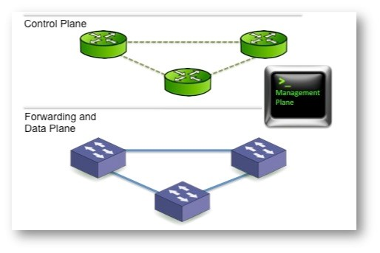
Logical Design for Control Planes

Slide 42
Segmentation
VLAN is a set of workstations within a LAN that can communicate with each other as though they were on a single, isolated LAN
The basic reason for splitting a network into VLANs is to reduce congestion on a large LAN

Slide 43
Advantages of Using VLANs
Performance
Formation of virtual workgroups
Greater flexibility
Ease of partitioning off resources

Slide 44
Common Attacks Against the Data-Link Layer
MAC Flooding Attack
802.1Q and Inter-Switch Link Protocol (ISL) Tagging Attack
Double-Encapsulated 802.1Q/Nested VLAN Attack
ARP Attacks
Multicast Brute-Force Attack
Spanning-Tree Attack
Random Frame Stress Attack

Slide 45
Secure Shell (SSH)
Secure Shell (SSH) services:
Include remote logon, file transfer, and command execution
Support port forwarding

Slide 46
Simple Network Management Protocol (SNMP)
Allows the manager to retrieve “get” values of variables from the agent, as well as “set” variables
Ports | Definition
161/TCP | UDP 162/TCP | UDP | RFC 1157

Slide 47
DNSSEC
The security extensions to DNS add protection for DNS records and allow the resolvers and applications to authenticate the data received
The point of DNSSEC is to provide a way for DNS records to be trusted by whoever receives them

Slide 48
The Network as a Bastion of Defense
Definition of Security Domains
Segregation of Security Domains
Incident Response Capability

Slide 49
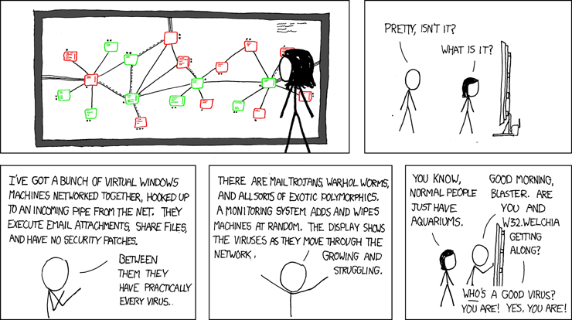

Slide 50
Network Security Objectives and Attack Modes
Perimeter defense
Defense in depth

Slide 51
Confidentiality
An eavesdropping computer can be a legitimate client on the network or an unauthorized one
Advantageous for an attacker to remain invisible on the network

Slide 52
Integrity
The property association with corruption or change (intentional or accidental)
A network needs to support and protect the integrity of its traffic

Slide 53
Availability
The property of a network service related to its uptime, speed, and latency
Availability of the service is commonly the most obvious business requirement

Slide 54
Domain Litigation
Domain names are subject to trademark risks, related to a risk of temporary unavailability or permanent loss of an established domain name

Slide 55
Open Mail Relay Servers
An SMTP service that allows inbound SMTP connections for domains it does not serve
Generally considered a sign of bad system administration

Slide 56
Firewalls
Firewalls are devices that enforce administrative security policies by filtering incoming traffic based on a set of rules

Slide 57
Filtering
Firewalls filter traffic based on a rule set
Each rule instructs the firewall to block or forward a packet based on one or more conditions
Two important conditions used to determine if a packet should be filtered are:
By Address
By Service

Slide 58
Network Address Translation (NAT)
Firewalls can change the source address of each outgoing packet to a different address
Non-routable address
Anonymity

Slide 59
Stateful Inspection or Dynamic Packet Filtering
Stateful inspection examines each packet in the context of a session
Allows dynamic adjustments to the rules

Slide 60
Proxies
A proxy firewall mediates communications between untrusted end-points and trusted end-points
Circuit-level Proxy
Application-level Proxy
Web Proxy servers

Slide 61
Personal Firewalls
Following the principle of security in depth, personal firewalls should be installed on workstations, which protect the user from all hosts on the network

Slide 62
Port Scanning
The act of probing for TCP services on a machine

Slide 63
FIN, NULL, and XMAS Scanning
In FIN scanning, a stealth scanning method, a request to close a connection is sent to the target machine

Slide 64
TCP Sequence Number Attacks
TCP attaches a sequenced number to each data packet that is transmitted
If a transmission is not reported back as successful, a packet will be retransmitted.
Eavesdropping allows a third party to predict the correct sequence number and introduce fake packets into the data stream.

Slide 65
Intrusion Detection Systems (IDS)
IDS monitor activity and send alerts when they detect suspicious traffic
Two broad classifications:
Host-based IDS
Network-based IDS

Slide 66
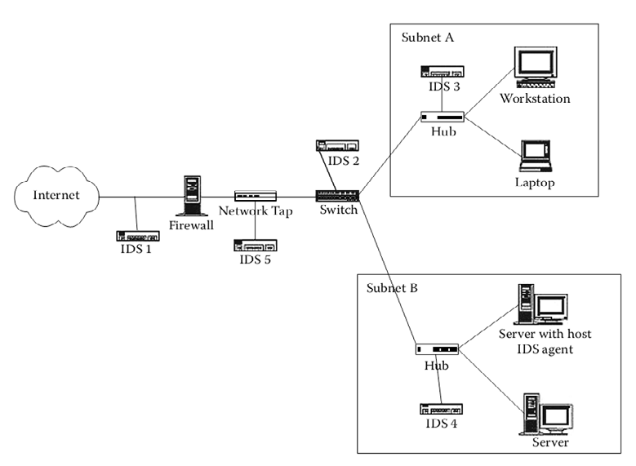
Architecture of an Intrusion Detection System (IDS)

Slide 67
SEM/SEIM
A solution that involves harvesting logs and event information from a variety of different sources on individual servers or assets and analyzing it as a consolidated view with sophisticated reporting

Slide 68
Scanners
Discover devices and services on a network
Test compliance with a given policy
Test for vulnerabilities

Slide 69
Scanning Tools
Nessus
Nmap

Slide 70
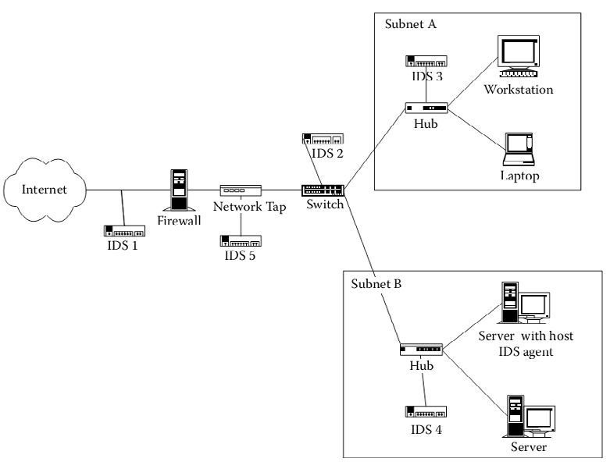
Network Taps

Slide 71
IP Fragmentation Attacks and Crafted Packets
Teardrop
Overlapping Fragment
Source Routing Exploitation
Smurf and Fraggle

Slide 72
Network Time Protocol (NTP)
NTP:
Synchronizes computer clocks in a network
Simple Network Time Protocol (SNTP):
Less resource intensive
Less exact form of synchronization

Slide 73
Denial-of-Service Attack (DoS)
Overload it through excessive traffic or traffic that has been “crafted” to confuse the network into shutting down or slowing to the point of uselessness

Slide 74
Distributed Denial-of-Service Attack (DDoS)
Using a network of remote-controlled hosts known as “botnets” the target is subjected to traffic from a wide range of sources that are very hard to block

Slide 75
SYN Flooding
A denial-of-service attack against the initial handshake in a TCP connection

Slide 76
IP Address Spoofing and SYN-ACK Attacks
Packets are sent with a bogus source address so that the victim will send a response to a different host
Spoofed addresses can be used to abuse the three-way handshake that is required to start a TCP session

Slide 77
DNS Vulnerabilities
Two principal vulnerabilities here:
It is possible for a DNS server to respond to a recursive query with information that was not requested.
The DNS server will not authenticate information

Slide 78
Information Disclosure
Although knowing a server name will not enable anyone to access it, this knowledge can aid and facilitate preparation of a planned attack

Slide 79
Namespace-Related Risks
Session hijack
IP spoofing
Man-in-the-middle attack
SYN scanning

Slide 80
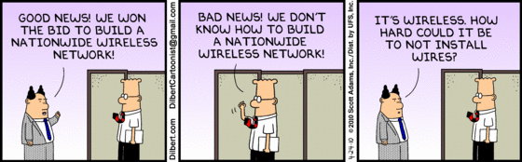

Slide 81
Types of Wireless Technologies
Wi-Fi
Bluetooth
WiMAX

Slide 82
Types of Wireless Networks
Wireless PAN
Wireless LAN
Wireless mesh network
Wireless MAN
Wireless WAN
Cellular network
Spread spectrum

Slide 83
Open System Authentication
The default authentication protocol for the 802.11 standard
Consists of:
A simple authentication request containing the station ID
An authentication response containing success or failure data

Slide 84
Shared Key Authentication
Shared Key Authentication is a standard challenge and response mechanism that makes use of WEP and a shared secret key to provide authentication

Slide 85
Ad Hoc Mode
One of the networking topologies provided in the 802.11 standard
Consists of at least two wireless endpoints where there is no access point involved in their communication

Slide 86
Infrastructure Mode
A networking topography in the 802.11 standard
Consists of a number of wireless stations and access points
The access points usually connect to a larger wired network

Slide 87
Wired Equivalent Privacy Protocol (WEP)
Basic security feature in the IEEE 802.11 standard
Provides confidentiality over a wireless network by encrypting information sent over the network

Slide 88
Wi-Fi Protected Access (WPA) and Wi-Fi Protected Access 2 (WPA2)
Provides users a higher level of assurance that their data will remain protected by using the Temporal Key Integrity Protocol (TKIP) for data encryption

Slide 89
A "Parking Lot" Attack
Attackers actually sit in the organization’s parking lot and try to access internal hosts via the wireless network
If a network is compromised, the attacker has achieved a high level of penetration into the network

Slide 90
Shared Key Authentication Flaw
Shared key authentication can easily be exploited through a passive attack by eavesdropping on both the challenge and the response between the access point and the authenticating client

Slide 91
Service Set Identifier (SSID) Flaw
If the default SSID is not changed, it is very likely that an attacker will be able to successfully attack the device due to the use of the default configuration

Slide 92
The Vulnerability of Wired Equivalent Privacy Protocol (WEP)
Data passing through a wireless LAN with WEP enabled is susceptible to eavesdropping and data modification attacks

Slide 93
Attack on Temporal Key Integrity Protocol (TKIP)
TKIP attack tries to decode data one byte at a time using multiple replays and observing the response over the air
An attacker can decode small packets such as ARP frames in about 15 minutes
If QoS is enabled, the attacker can further inject up to 15 arbitrary frames for every decrypted packet

Slide 94
